Slide 1
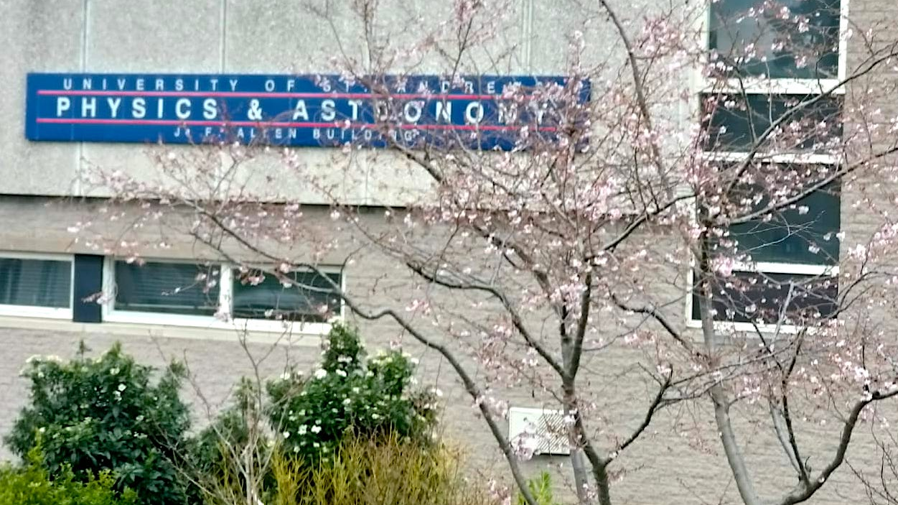
Garden Project
Paula Stella Teixeira, Vivienne Wild, Janet Lovet, EDI, Alistair Mcleod, Miriam West, Veronika Vašíčková

Slide 2
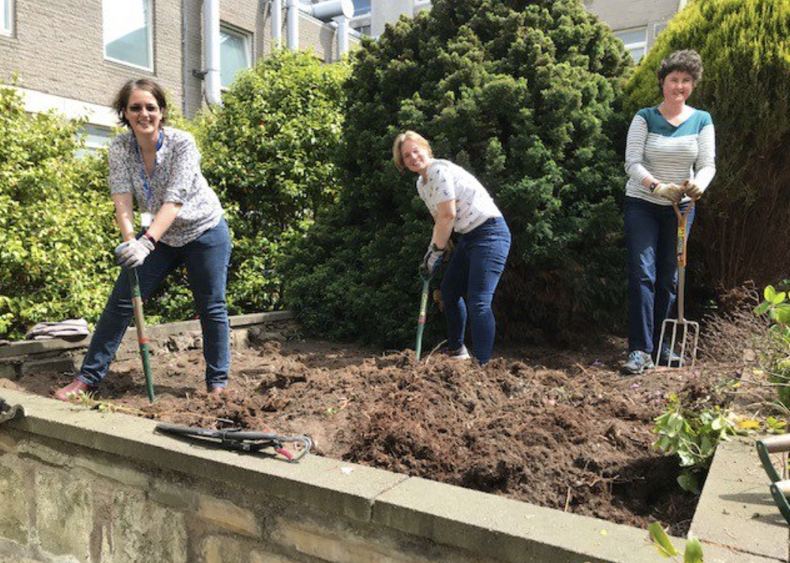
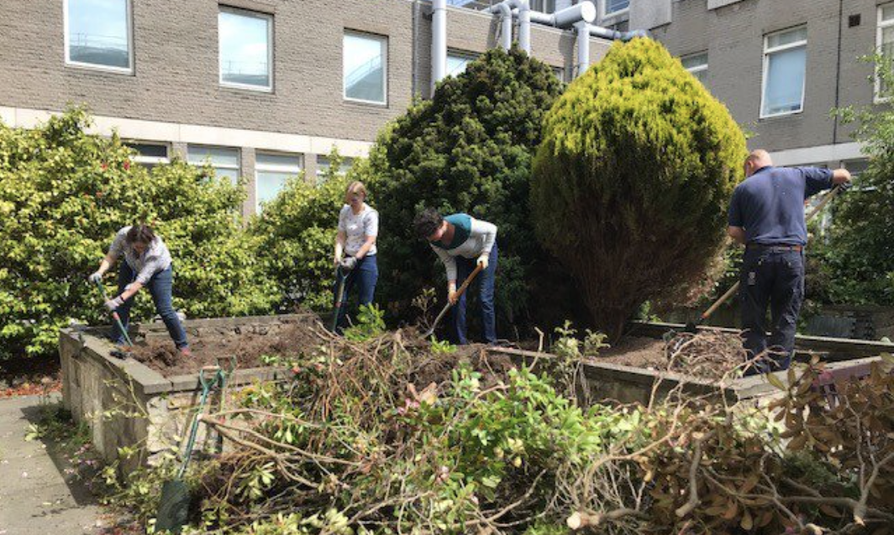
Autumn 2021: Wellbeing action plan of the EDI
Spring 2022: Start pilot project with Transitions Team
- cleared the bed from shrubs and roots
- prepared soil with compost
- began planting vegetables

Slide 3
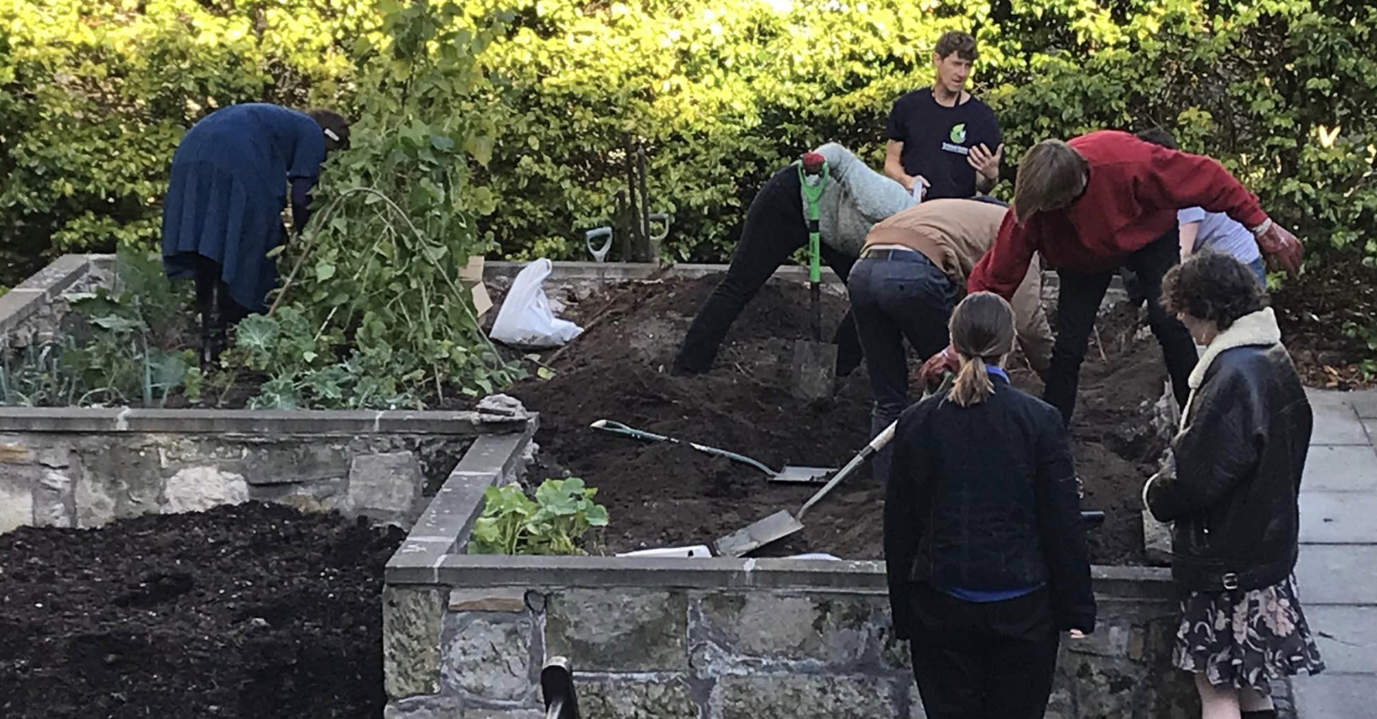
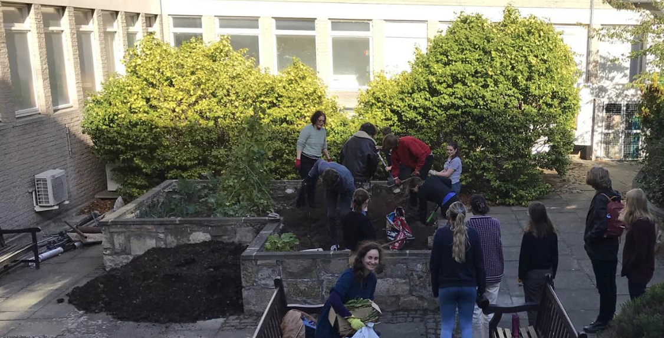
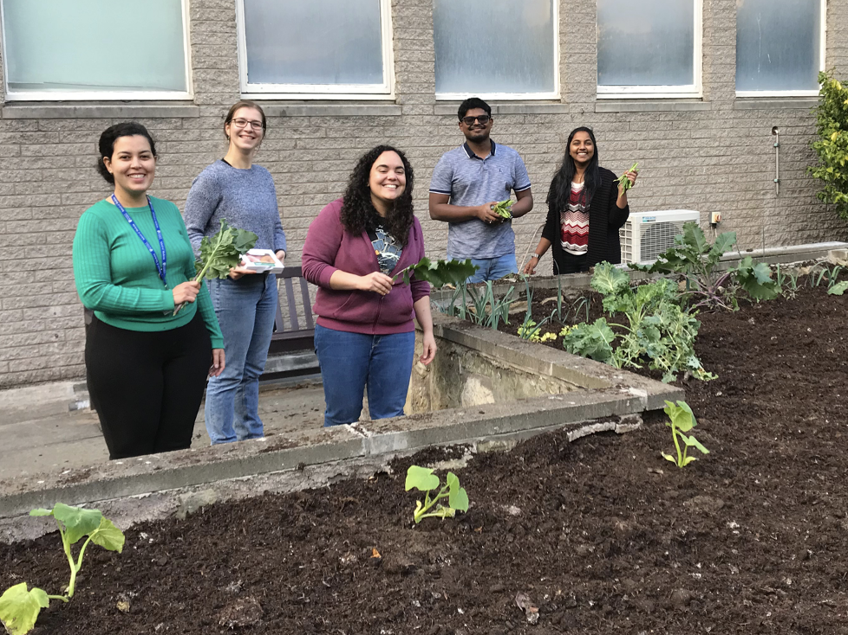
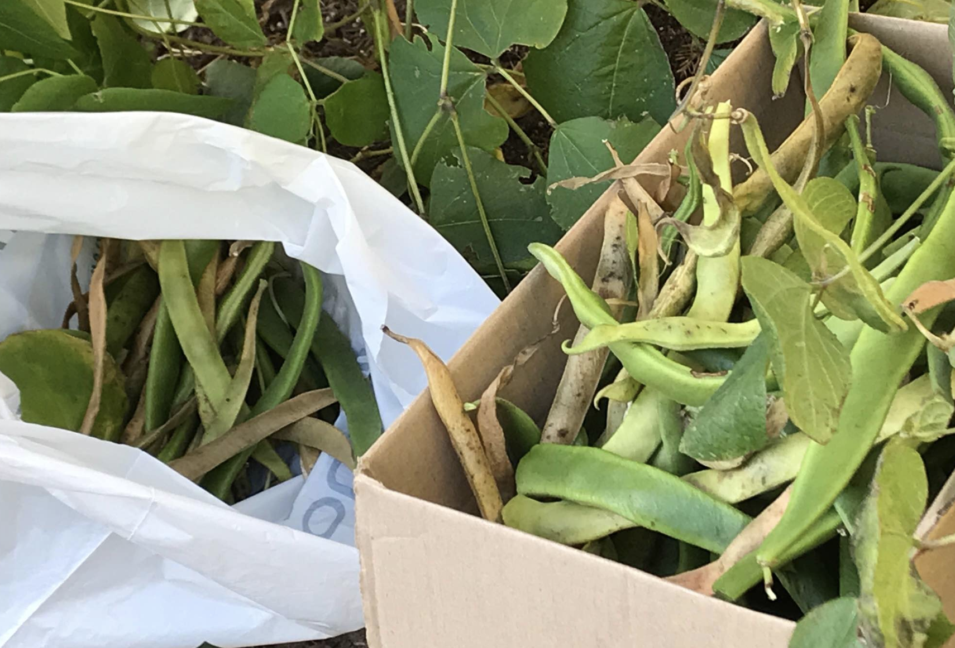
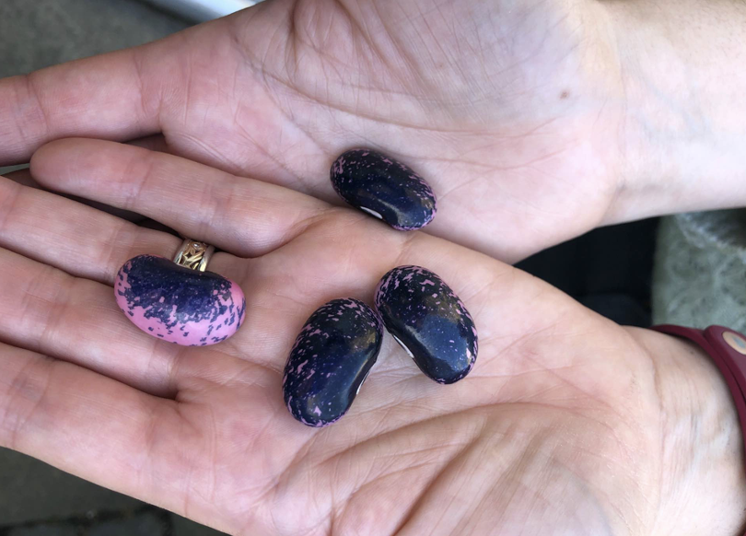
Summer 2022: Gardening sessions, harvesting

Slide 4
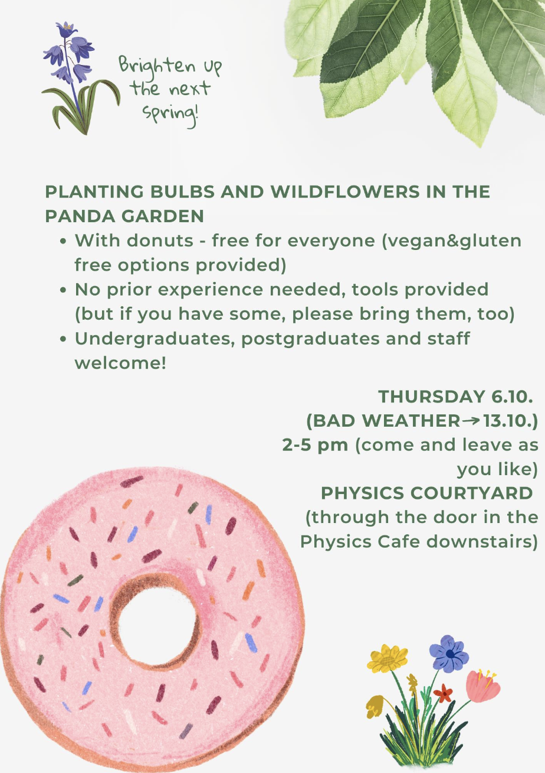

Autumn 2021: Wellbeing action plan of the EDI
Spring 2022: Start pilot project with Transitions Team
- cleared the bed from shrubs and roots
- prepared soil with compost
- began planting vegetables
Summer 2022: Gardening sessions, harvesting
Autumn 2022: Planted Scottish native wild bulbs

Slide 5
Autumn 2021: Wellbeing action plan of the EDI
Spring 2022: Start pilot project with Transitions Team
- cleared the bed from shrubs and roots
- prepared soil with compost
- began planting vegetables
Summer 2022: Gardening sessions, harvesting
Autumn 2022: Planted Scottish native wild bulbs
Winter 2022: applied for Enhancement funding
Spring 2023: Purchasing gardening material
Build toolshed, solar powered watering system
Gardening sessions

Slide 6
Physics and Astronomy Garden
Collaborative project
Research academic staff
Professional Services
Wellbeing
Sustainability
Students
Student feedback
"improved physical and mental health"
“Enhanced sense of community at the School”
Notes:
Can be replicated on other Schools
Can be used to test sustainable and robust watering system during summer months

